Slide 1
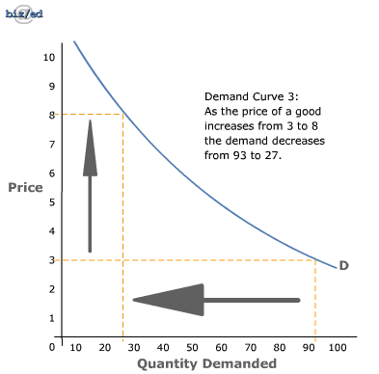
Chapter 4 - Demand

Slide 2
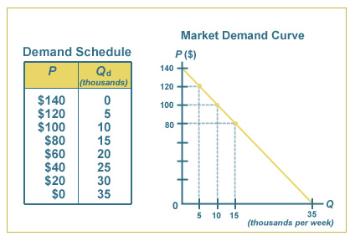
Chapter 4
Demand – The desire, ability, and willingness to buy a product – can compete with others who have similar demands

Slide 3
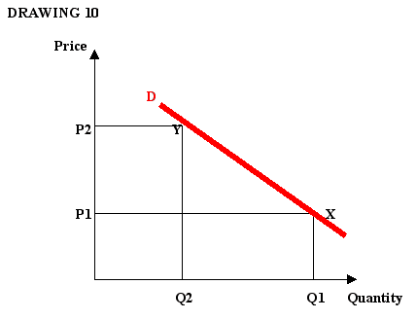
Chapter 4
Demand Schedule – A listing that shows the various quantities demanded of a particular product at all prices that might prevail in the market at a given time – show example
Demand Curve – A graph showing the quantity demanded at each and every price that might prevail in the market – show example

Slide 4
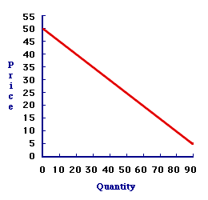
Chapter 4
Law of Demand – the quantity demanded of a good or service varies inversely with its price
When price goes up, demand goes down
When price goes down, demand goes up
Ceteris Paribis- all things held constant or equal. “A Moment frozen in time.”

Slide 5
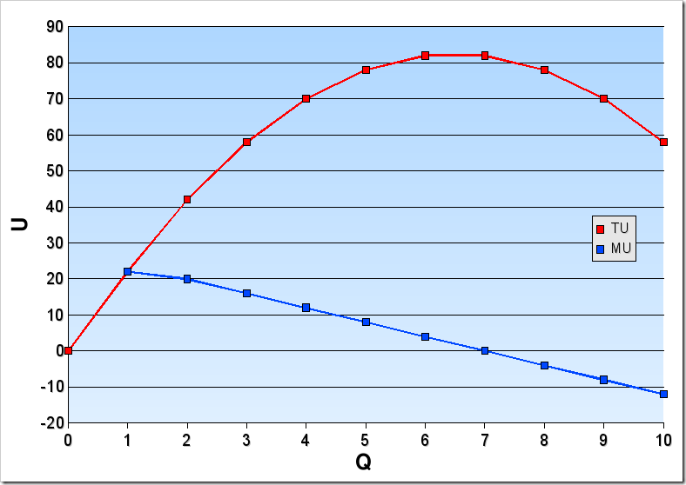
Chapter 4
Marginal Utility – The extra usefulness or satisfaction a person gets from acquiring or using one more unit of a product
Diminishing Marginal Utility – The extra satisfaction we get from using additional quantities of the product begins to diminish

Slide 6
We all love in-n-out (to an extent)
Graph the Demand of In-N-Out
You get the point…

Slide 7
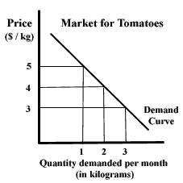
Chapter 4
Change in Quantity Demanded (Qd)
There are two factors that affect quantity demanded: (graphical representation)
a movement ALONG the demand curve
1) The Income Effect- change in Qd because of a change in price that alters consumers’ real income
Buy 6 albums at $15 = $90; price drops to $10/album = $60
$30 “richer”
2) The Substitution Effect- change in Qd because of a change in the relative price of a product

Slide 8
Chapter 4
6 Factors affecting demand
1) Consumer income- a rise in income will result in a general increase in demand
Demand curve will SHIFT outwards (to the right)
A decrease in income will result in a general decrease in demand (to the left)

Slide 9
Chapter 4
2) Consumer tastes
Trends, new products, seasonal trends, popularity
3) Substitutes-a change in price of related products can cause a change in demand
Butter vs margarine
4) Complements-the use of one increases the use of the other
Computers and software
A change in price will change demand for both in the same direction

Slide 10
Chapter 4
5) Change in expectations- expectations of a product in the future
Iphone
Car-buying time
6) Number of consumers- affects the market demand curve (the sum of all individual demand curves)
The more consumers the greater demand (in general)
The fewer consumers the less demanded (in general)

Slide 11
Warm Up #1
What is Diminishing Marginal Utility?
What is the relationship between price and quantity demanded?
What is Ceteris Paribis?
What are two factors that would have movement ALONG the demand curve?
What are the (6) factors that SHIFT the demand curve?
Follow the demand schedule on the board and graph (label your graph ENTIRELY).
CEQ: What is FEMA and what is their responsibility? How many are expected to be permanently displaced by Hurricane Harvey? What is the estimated
economic cost of Hurricane Harvey?
Notes:
Income effect
Substitution effect

Slide 12
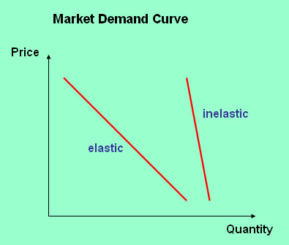
Chapter 4
Elasticity – A measure of responsiveness that tells us how a dependent variable such as quantity responds to a change in an independent variable such as price
Demand Elasticity – The extent to which a change in price causes a change in the quantity demanded

Slide 13
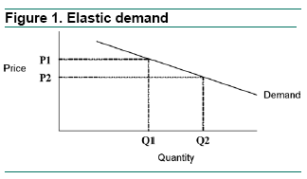
Chapter 4
Elastic Demand – When a given change in price causes a relatively larger change in quantity demanded

Slide 14
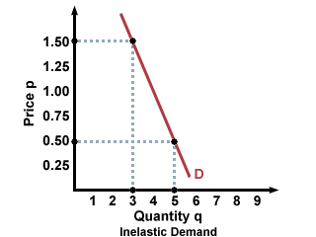
Chapter 4
Inelastic Demand – A given change in price causes a relatively smaller change in the quantity demanded

Slide 15
Chapter 4
Unit Elastic – a given change in price causes a proportional change in quantity demanded

Slide 16
Warm Up #7
What is the economic definition of “Elasticity”
What does “Inelastic” mean?
Would a “Want” most likely be elastic or inelastic? How about a “Need”?
See the board and identify the “Elastic” line and the “Inelastic” line
What does “Unit Elastic” mean?
What are the two factors that cause movement ALONG the demand curve?
What are the six factors that cause the demand curve to shift?
Notes:
Income effect
Substitution effect
Consumer Income
Consumer tastes
Compliments
Substitutes
Change in expectations
Change in consumers

Slide 17
Chapter 4
Factors affecting Elasticity of demand
Availability of substitutes
Luxury vs. necessity
Can the purchase be delayed
Portion of income needed to purchase

Slide 18
All Content Created by DJ Cook

